Slide 1

π
Runnables
May 2024
π

Slide 2

π
Tools We will cover?

Slide 3
π
Runnables
Basics ?
typeDictionary
Pydantic
JsonOutputParser
StructuredoutputParser
Pydanticoutparser
π

Slide 4
π
Runnable
Langchian

Slide 5
π
Runnables type
Task specfic Runnables
Premitive-Runnables
Notes:
Content: https://www.linkedin.com/pulse/chunking-strategies-ai-data-kash-kashyap-0lghe/

Slide 6
π
Notes:
Content: https://www.linkedin.com/pulse/chunking-strategies-ai-data-kash-kashyap-0lghe/

Slide 7
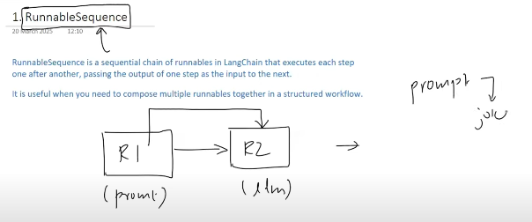
π
Notes:
Content: https://www.linkedin.com/pulse/chunking-strategies-ai-data-kash-kashyap-0lghe/

Slide 8
π
from dotenv import load_dotenv
from langchain_google_genai import ChatGoogleGenerativeAI
from langchain_core.prompts import PromptTemplate
from langchain_core.runnables import RunnableSequence
from langchain_core.output_parsers import StrOutputParser
load_dotenv()
model=ChatGoogleGenerativeAI(model="gemini-2.0-flash", temperature=0)
parser=StrOutputParser()
temp=PromptTemplate(
template="generate a joke about {topic}",
input_variables=[“topic” ])
chain=temp | model | parser
res = chain.invoke({ “topic”: “monkey”})
print(res)
Notes:
Content: https://www.linkedin.com/pulse/chunking-strategies-ai-data-kash-kashyap-0lghe/

Slide 9
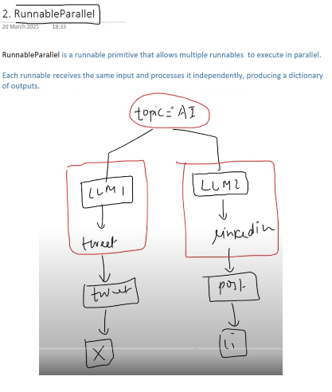
π
RunnableParallel
Notes:
Content: https://www.linkedin.com/pulse/chunking-strategies-ai-data-kash-kashyap-0lghe/

Slide 10
π
from dotenv import load_dotenv
from langchain_google_genai import ChatGoogleGenerativeAI
from langchain_core.prompts import PromptTemplate
from langchain_core.runnables import RunnableSequence, RunnableParallel
from langchain_core.output_parsers import StrOutputParser
load_dotenv()
model=ChatGoogleGenerativeAI(model="gemini-2.0-flash", temperature=0)
parser=StrOutputParser()
promp1=PromptTemplate( template="generate a joke about {topic}", input_variables=[“topic” ])
prompt2=PromptTemplate( template="generate a joke about {topic}", input_variables=[“topic” ])
parallel_chain=RunnableParallel({
"tweet“ : RunnableSequence(prompt1,model,parser),
"LinkedIn": RunnableSequence(prompt1,model,parser)
})
print(parallel_chain.invoke({"topic":"AI"}))
{
'tweet': 'AI is rapidly evolving, and the possibilities are endless! ',
'linkkedin': 'AI is rapidly evolving, and the possibilities are endless!'
}
Notes:
Content: https://www.linkedin.com/pulse/chunking-strategies-ai-data-kash-kashyap-0lghe/

Slide 11
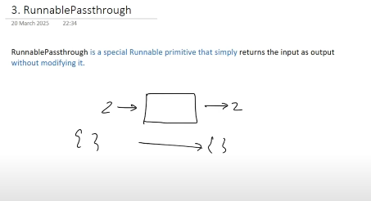
π
RunnablePassthrough
Notes:
Content: https://www.linkedin.com/pulse/chunking-strategies-ai-data-kash-kashyap-0lghe/

Slide 12
π
from dotenv import load_dotenv
from langchain_google_genai import ChatGoogleGenerativeAI
from langchain_core.prompts import PromptTemplate
from langchain_core.runnables import RunnableSequence, RunnableParallel
from langchain_core.output_parsers import StrOutputParser
load_dotenv()
model=ChatGoogleGenerativeAI(model="gemini-2.0-flash", temperature=0)
chain=RunnablePassthrough()
res=chain.invoke(777)
print(res)
Notes:
Content: https://www.linkedin.com/pulse/chunking-strategies-ai-data-kash-kashyap-0lghe/

Slide 13
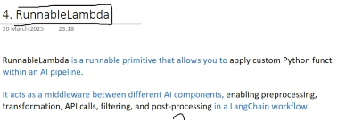
π
Notes:
Content: https://www.linkedin.com/pulse/chunking-strategies-ai-data-kash-kashyap-0lghe/

Slide 14
π
from dotenv import load_dotenv
from langchain_google_genai import ChatGoogleGenerativeAI
from langchain_core.prompts import PromptTemplate
from langchain_core.runnables import RunnableLambda
from langchain_core.output_parsers import StrOutputParser
load_dotenv()
model=ChatGoogleGenerativeAI(model="gemini-2.0-flash", temperature=0)
def toUpperCase(x:str):
return x.upper()
chain=RunnableLambda(toUpperCase)
res=chain.invoke("hello world")
print(res)
Notes:
Content: https://www.linkedin.com/pulse/chunking-strategies-ai-data-kash-kashyap-0lghe/

Slide 15
π
RunnableBranch
Runnable that selects which branch to run based on a condition.
Notes:
Content: https://www.linkedin.com/pulse/chunking-strategies-ai-data-kash-kashyap-0lghe/

Slide 16
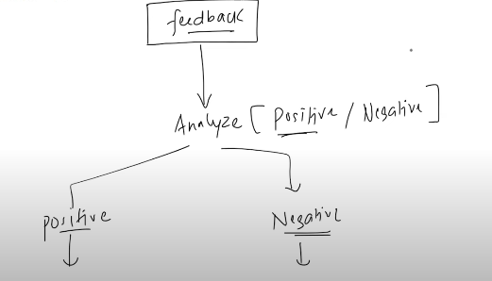
π
Notes:
Content: https://www.linkedin.com/pulse/chunking-strategies-ai-data-kash-kashyap-0lghe/

Slide 17
π
from dotenv import load_dotenv
from langchain_google_genai import ChatGoogleGenerativeAI
from langchain_core.prompts import PromptTemplate
from langchain_core.runnables import RunnableBranch
from langchain_core.output_parsers import StrOutputParser
load_dotenv()
model=ChatGoogleGenerativeAI(model="gemini-2.0-flash", temperature=0)
class Review(BaseModel):
sentiment:Literal["positive","negative"]=Field(description="give me sentiment of feedback")
parser_pydantic=PydanticOutputParser(pydantic_object=Review)
parser_str=StrOutputParser()
prompt=PromptTemplate(
template="classify a sentiment of following feedback into positive or negative \n {feedback} \n {format_instruction}",
input_variables=["feedback"],
partial_variables={"format_instruction":parser_pydantic.get_format_instructions },
)
Notes:
Content: https://www.linkedin.com/pulse/chunking-strategies-ai-data-kash-kashyap-0lghe/

Slide 18
π
prompt1=PromptTemplate(
template="generate two line response for this positive feedback \n {feedback}" ,
input_variables=["feedback"]
)
prompt2=PromptTemplate(
template="generate two line response for this negative feedback \n {feedback}" ,
input_variables=["feedback"]
)
classfier_chain=prompt|model|parser_pydantic
branch_chain = RunnableBranch(
( lambda x:x.sentiment== 'positive', prompt1 | model | parser_str ),
( lambda x:x.sentiment == 'negative', prompt2 | model | parser_str ),
RunnableLambda(lambda x: “could not find sentiment")
)
chain=classfier_chain | branch_chain
result=chain.invoke({ "feedback“ : "The product is amazing and great !“ })
print(result)
Notes:
Content: https://www.linkedin.com/pulse/chunking-strategies-ai-data-kash-kashyap-0lghe/

Slide 19


π
Q & A

